Slide 1



G. H. Raisoni College of Engineering & Management, Pune. Department of Computer Engineering
Vulnerable University
Guide : - Prof. Gayatri Bedre
Presented By : -
BCOA03 – Abhishek Birdawade
BCOB93 – Srushti Deshpande
BCOB111 – Vaibhav Wagh

Slide 2


Contents
Introduction
Literature Survey
Existing System
Problem Statement
Proposed System
Objectives
System Architecture Diagram
Modules
Algorithm/Technology Used
UML Diagram
Hardware & Software Used
Advantages & Disadvantages
Applications
Conclusion
References

Slide 3

Introduction
Cyber criminals are more sophisticated, changing the attacking approach and they are creating a really crucial conditions for organizations by affecting their image.
The vulnerable web applications can be used by web developers, security auditors, and penetration testers to practice their knowledge and skills during training sessions (and especially afterwards), as well as to test at any time the multiple hacking tools and offensive techniques available, in preparation for their next real-world engagement.
Vulnerable applications available to security professionals for hacking, offensive and defensive activities, so that they can manipulate realistic web environments… without going to jail ☺.
Security Professionals can practice and enhance their skills regarding web application security testing by learning and practicing about various technical and non-technical bugs and vulnerabilities.

Slide 4
Literature Survey
Sr. No. | Paper Title | Author Name | Date | Findings
1. | Security Testing: A Survey | Michael Felderer, Matthias Büchler, Martin Johns | 03/11/2015 | This chapter provided a broad overview of recent security testing techniques.
2. | A security testing platform for Wireless Sensor Networks | Min Wei, Shuaidong Zhang, Keecheon Kim | 10/03/2016 | The test results show that the platform is a feasible platform for assessing device security levels in WSNs.
3. | Vulnerability Analysis Using the Interactive Application Security Testing (IAST) Approach for Government X Website Applications | Hermawan Setiawan, Lytio Enggar Erlangga, Ido Baskoro | 29/01/2021 | Using the IAST approach, a total of 249 vulnerability risks were identified.

Slide 5
Literature Survey
Sr. No. | Paper Title | Author Name | Date | Findings
4. | Intelligent Testing in Software Industry | Anushka Lal, Girish Kuma | 03/11/2021 | This study aims to investigate the approach of intelligent testing for improving software testability.
5. | Automated Cyber Security Testing Platform for Industrial Control System | Andrew Hahn, Daniel R. Sandoval, Raymond E. Fasano, Christopher Lamb | 23/10/2021 | A platform that incorporates these three components to provide the most accurate representation of actual NPP networks and controllers is developed in this paper.

Slide 6

Existing System
Hack The Box
Hack The Box is an online platform allowing security professionals to test their penetration testing skills and exchange ideas and methodologies with other members of similar interests. It contains several challenges that are constantly updated. Some of them simulating real world scenarios and some of them leaning more towards a CTF style of challenge.
Advantages - As an individual, they can complete a simple challenge to prove their skills and then create an account, allowing them to connect to HTB private network (HTB Net) where several machines await for them to hack them. By hacking machines they get points that help them advance in the rankings.
Disadvantage – On this platform security professionals has to compete with others, so they invest their most of the time in competing with others rather than investing on their own skills.
https://hackthebox.com/

Slide 7

Existing System
TryHackMe
TryHackMe takes the pain out of learning and teaching Cybersecurity. Our platform makes it a comfortable experience to learn by designing prebuilt courses which include virtual machines (VM) hosted in the cloud ready to be deployed. This avoids the hassle of downloading and configuring VM's. Our platform is perfect for CTFs, Workshops, Assessments or Training.
Advantages – Free basic learning and testing applications available to the masses.
Disadvantages – For paid subscription is needed for intermediate or advanced learning and testing on the platform
https://tryhackme.com/

Slide 8

Problem Statement
Cyber security is a vast field and immerging daily. With increasing digital theft and cyber criminals, we need security tester and practitioner to help us tackle the increasing problem.
It is necessary for them to learn testing without violating cyber laws.
The vulnerable web application will provide a platform to learn and test their skills in their own local environment.

Slide 9
Proposed System
Vulnerable University is damn vulnerable application which any user can easily download from our GitHub page for free and run on their local system with single command.
This application can also be used using Docker file for platform independency and without having need to download and install dependencies to run the application.
Our application consists of different technologies and their associated vulnerabilities for not only testing but also for learning and understanding different bugs.
Objectives
To identify the threats in the web application, servers & websites.
To find potential vulnerabilities of the system and try to resolve those vulnerabilities.
To help in detecting to every possible security risk in the system.
Examine the impact occurs due to vulnerabilities.
To help the organizations and developer teams to resolving the security problem.
Improve the skills of the security professionals.
Introducing the various kind of hacking techniques without violating cyber laws.
Provide cyber education to students regarding technical and non-technical vulnerabilities.

Slide 10
Proposed System
System Architecture Diagram
Command Injection
SQL Injection
Broken Authentication
Sensitive Data Exposure
Security misconfiguration
Browser
User
(Security Professional)
Request
Insecure deserialization
Broken Access Control
Response
Using component with known vulnerability
Cross-site scripting XSS
Client
Client Side
SSRF
XML entity
Vulnerable University - Application

Slide 11
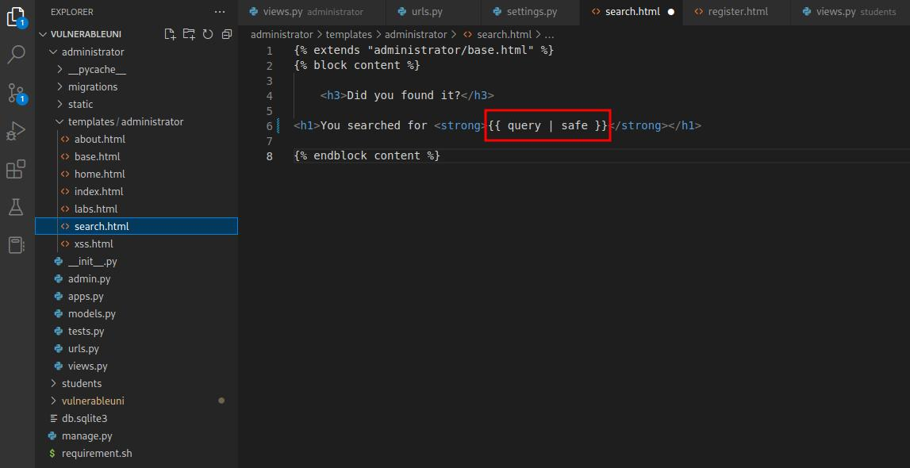
Proposed System
III. Module
Vulnerable Component

Slide 12
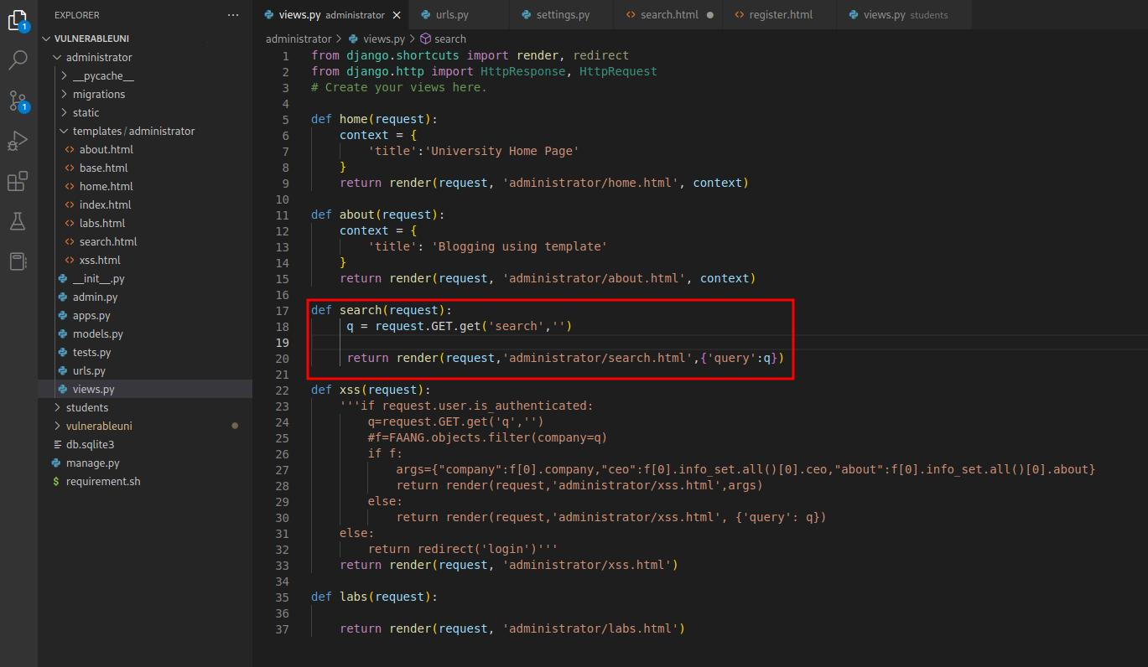
Proposed System
III. Module
Vulnerable Component

Slide 13
Proposed System
Technology Used
Django –
Django is free, open source and written in Python. We design application using Django because Django makes it easier to build application using Python. Django takes care of the difficult stuff so that we can concentrate on building our application. Django emphasizes reusability of components, also referred to as DRY (Don't Repeat Yourself), and comes with ready-to-use features like login system, database connection and CRUD operations (Create Read Update Delete).
Docker –
Docker is a set of platform as a service products that use OS-level virtualization to deliver software in packages called containers. The service has both free and premium tiers. The software that hosts the containers is called Docker Engine. By using this technology we make our application platform friendly. So, anyone can run this application on their own local system.

Slide 14
Proposed System
V. Block Diagram
Researchers
Researchers download the application and run on their local system
Vulnerable University
Researchers will find vulnerabilities within the scope of application.
Vulnerability
Learn & Report Vulnerabilities.
Learning and Report

Slide 15
Proposed System
VI. UML Diagram
Report
Severity
Prepare
Date : date
Title : string
Low
Medium
High
Critical
User
Security Professionals : string
Testers : string
Developers : string
Application
Types of Vulnerabilities
Login
Home page
Admin page
XSS
Login
Home page
Admin page
XSS
Test

Slide 16
Proposed System
VII. Hardware & Software Used
Hardware Requirement
• 1 TB HDD
• 4/8 GB RAM
• i5 or above processor
2. Software Requirement
Operating System – Linux, Windows, Mac (platform independent)
Web Browser – Chrome, Firefox, etc
Docker
GitHub
Python - Django

Slide 17
Advantages & Disadvantages
Advantages –
Vulnerable University is a platform, which have various kind of vulnerabilities their to practice.
This application is free to for anyone and easily available for them.
It is platform independent.
This application is not only for testing or practicing but also for learning different types of bugs.
Disadvantages –
Before accessing this application user must have some basic understanding of testing.
Users can misuse this skills.

Slide 18
Applications
Security Professionals can brush up their skills, even can learn some different vulnerabilities.
For developers, this application can help them to understand, how attackers can hack their application, they can understand the types of bugs.
Students are able to practice finding technical and non-technical web-application vulnerabilities in their local environment

Slide 19
Conclusion
Cyber Security is method of protecting and securing the computer devices, network and program from cyber-attack. The importance of cyber security is rising.
Cyber criminals are more sophisticated, changing the attacking approach and they are creating a really crucial conditions for organizations by affecting their image.
Vulnerable university helps to enhance the skills of security professionals as well as this application helps to spread awareness about the ethical hacking amongst students. Anyone can easily get access of this free application and can run on their local environment. Students can learn required skills and can earn decent amount by finding valid bugs for many organizations on various platforms.

Slide 20
References
https://www.researchgate.net/publication/297918097_Security_Testing_A_Survey
https://ieeexplore.ieee.org/document/7427093/metrics#metrics
https://www.cigniti.com/resource/white-papers/security-testing-tools-experiences-recommendations/
https://www.osti.gov/servlets/purl/1854691
https://securitytrails.com/blog/vulnerable-websites-for-penetration-testing
https://tryhackme.com/network/throwback
https://tryhackme.com
https://hackthebox.com
https://github.com/abhhi-101/vulnerable-university

Slide 21
References
Thank You

